Slide 1
The 5 (I did 6) Main Religions on Earth

Slide 2
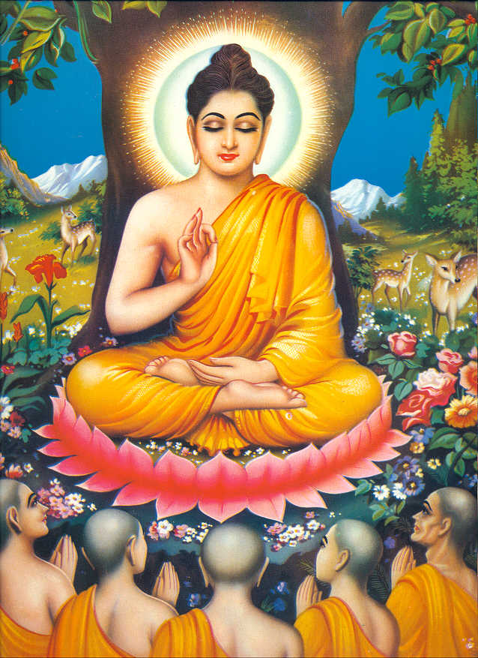
Buddhism
Buddhism is founded by Siddhartha Gautama (The Buddha)
Siddhartha Gautama lived in the 4th or 5th B.C in India
The Sacred Text is Tripitaka
The Sacred Building is Stupa
The religion is 2,500 years old
There is over 350 million Buddhists worldwide.
Buddhism is the main religion in many Asian countries.
The key concept is Nirvana
Buddhism is different from other religions because Buddhists do not believe in a personal creator God. Also, it is not centred on the relationship between humanity and God
The Major Festival is Wesak
Buddhism is about suffering and the need to get rid of it.
Main Branches (Denominations) of Buddhism is Theravada, Mahayana, Tibetan, Chinese and Japanese groups including Soto and Zen
Buddhism began in Northeastern India
"The Buddha" is born in Nepal in the village of Lumbini around 580 BC
Siddhartha Gautama was once a Prince

Slide 3
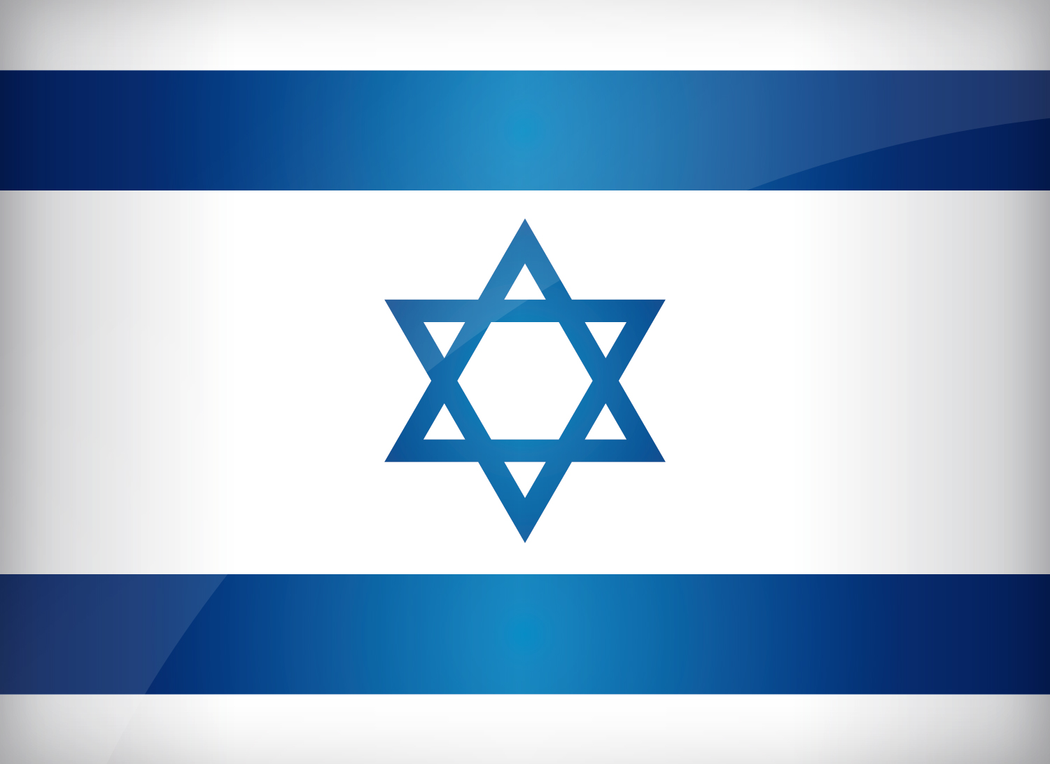
Judaism
Judaism is the oldest of the world's four biggest monotheistic religions. (A religion with only one god.)
Place of Origin of Judaism is in Israel
The founder of Judaism is Abraham
The Torah (Jewish Law) is the primary document of Judaism.
It is the smallest religion, with only 12 million people followers worldwide.
Judaism begins with the covenant established between God and Abraham around 1812 BC in the Bronze Age.
Began in the Middle East
Jewish calendar starts with the day when Adam and Eve were created (the Sixth Day of Creation)
The year 2010 on the Jewish calendar is 5770.
The Sacred Text of Judaism is The TeNaCh. (Torah, Nevi'im, Ketuvim)
The Sacred Building of Judaism is Synagogue.
The Menorah is one of the oldest symbols of the Jewish faith.
The Major Festivals of Judaism is Rosh Hashanah and Yom Kippur, Pesach (Passover), Shavuot (Pentecost), Sukkot (Tabernacles)
Last but not least, The Main Branches (Denomination) of Judaism is Orthodox, Reform, Conservative
Special things that Jews wear is a Kippah and a Tallit.

Slide 4

Christianity
Christianity is the world's biggest religion, with about 2.2 billion followers worldwide.
The founder of Christianity was Jesus of Nazareth
Jesus is the son of God
The Sacred Text of Christianity is the Bible
The name “Christianity” was named after Jesus’s last name, Christ
The place of origin for Christianity is Israel
Jesus is a Jew
Jesus was born about 2000 years ago in Bethlehem
Jesus died at the age of 33
Christians are people who believe that Jesus Christ is the Son of God
The Sacred Building of Christianity is a church
Based on the teachings of Jesus Christ
The Holy Places of Christianity are , Bethlehem, Nazareth, Lourdes, Rome, Canterbury
The major festivals of Christianity are Easter and Christmas
The Major Branches are Anglican, Roman Catholic, Free Churches, Orthodox, and Reformed
The cross is the main symbol
The dove is the symbol of the holy spirit and peace

Slide 5
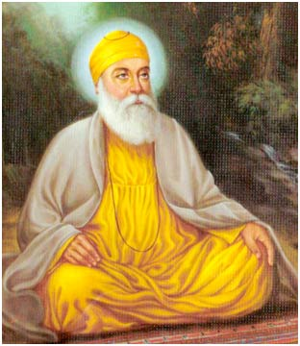
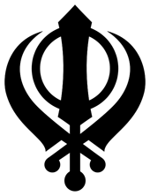
Sikhism
Sikhism was just founded around 500 years ago
Sikhism is the fifth populated religion with just about 20 million followers
The founder of Sikhism is Guru Nakak
Sikh in the Pubjabi language means disciple
Sikhs are the disciples of God who follow the writings and teachings of the Ten Sikh Gurus
The place of origin of Sikhism is Punjab, in Northeastern India
The Sacred Text of Sikhism is the Guru Granth Sahib
Sikhism teaches that all human beings are equal
The symbol of Sikhism is known as the Khanda
The Sikhism Sacred Building is the Gurdwara
Their Holy Place was where Guru Nakak was born, Nankana Sahib
The Sikhism Major Festivals are Hola Mohalla, Baiskhi, Diwali, and Guru Nakak's birthday
Sikhs do not believe in smoking, superstitions, ritualism, caste system, alcohol, drugs and fasting

Slide 6
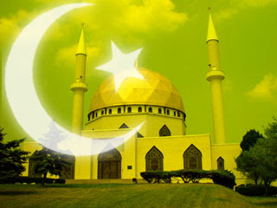

Islam/Muslim
Islam is the second largest religion in the world, with over one billion followers
Islam is often thought of as a complete way of life than a religion
The Place Of Origin of this religion was in Saudi Arabia
Muslims believe in only one god, Allah
Islam is mainly followed in Asia, Northern Africa, and the Middle East
The word "Islam" in Arabic is submission and obedience
Approximately 90% of Muslims are Sunnis, while the Shiites are the second largest group
The Shiites was split from the Sunnis when Muhammad died in 632
The Muslim year is based off of the Lunar Calendar
The five pillars of Islam are Shahadah, Salah, Zakat, Saum, and Hajj
Muslims are required to pray five times a day, wash themselves before praying, and while praying, has to face in the same direction as the Mecca
The Sacred Text of Islam is The Qur'an
The Islam Sacred Building is a Mosque
Their Holy Places are Mecca, Medina, and Jerusalem
The Major Festivals are Ramadan, Eid-ul-Ahda, and Eid-ul-Fitr
Their symbol is a moon facing a star at around 75 degrees

Slide 7
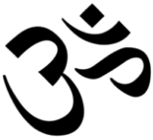
Hinduism
Hinduism is often referred as Sanātana Dharma
Hinduism is the world's third largest religion, with about 750 million followers
The Place of Origin is in Northern India, near Indus River
Hinduism is the oldest existing religion, about 4,000 years old
Hinduism is practiced by more than 80% of India's population
The main symbol of Hinduism is Aum
Hinduism has no founder, but it was developed out of Brahminism
"Hindu" came from the river Indus
Hinduism is different from other religions because it has no founder
The Hinduism Sacred Text is Vedas, and Upanishads
Their Sacred Building is the Mandir
Hindus believe in only one god, Brahman
There were three forms of Brahman, Brahma, Vishnu, and Shiva
There is a total of 330 million gods
The Sacred Festival is Divali
The Holy Places of Hinduism is River Ganges, but that's just one of many

Slide 8
Works Cited
Barrow, Mandy. "Buddhism for Children." Buddhism for Children. N.p., 2013. Web. 06 Dec. 2016.
Barrow, Mandy. "Judaism for Children." Judaism for Children. N.p., 2013. Web. 07 Dec. 2016.
Barrow, Mandy. "Information on Christianity" Christianity for Kids. N.p., 2013. Web. 08 Dec. 2016.
Barrow, Mandy. "Sikhism for Children." Sikhism for Children. N.p., 2013. Web. 09 Dec. 2016.
Barrow, Mandy. "Islam (Muslim) for Kids." Islam (Muslim) for Kids. N.p., 2013. Web. 09 Dec. 2016.
Barrows, Mandy. "Information on Hinduism for Kids." Information on Hinduism for Kids. N.p., 2013. Web. 10 Dec. 2016.

